Slide 1
The Look Performance Analysis
Afrizal A Makatita
Friday, April 10 2026
RevoU FSDA BATCH FEB26

Slide 2
Company
Overview
TheLook is a fictitious eCommerce clothing site developed by Looker Team TheLook eCommerce currently, is in the optimization mode caused by the potential crisis of 2023. The management has decided to cut off resources in some categories with the lowest growth in the past 1 year

Slide 3
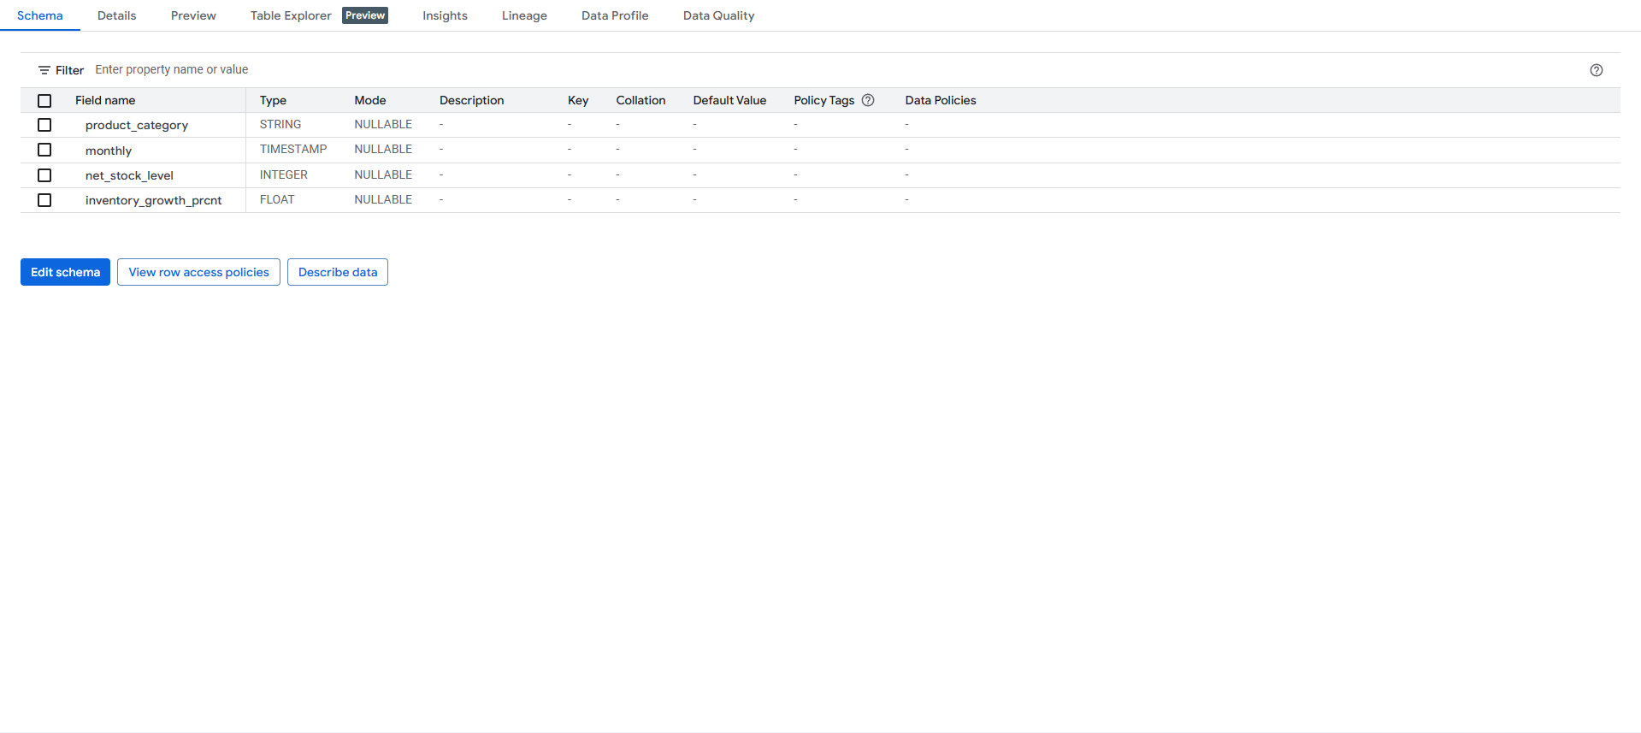
Table Scheme and Preview

Slide 4
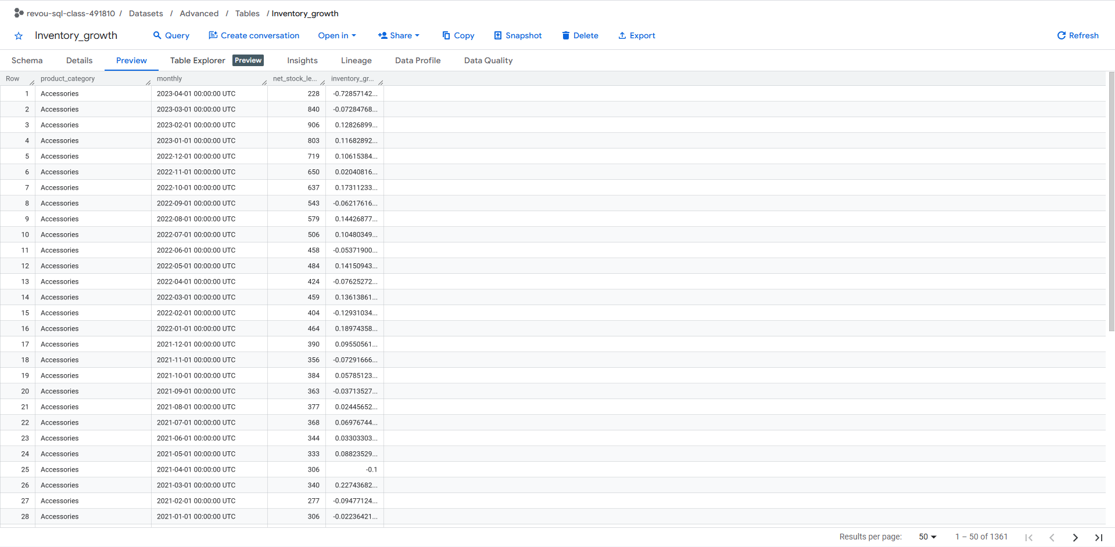
Table Scheme and Preview

Slide 5
Monthly Inventory Growth by Product Category Syntax Advanced_Query
WITH cte_1 AS (
SELECT
ii.product_category,
DATE_TRUNC(ii.created_at, MONTH) AS monthly,
COUNT(ii.id) AS total_inbound ,
-- Menggunakan COUNT(oi.id) untuk menghitung barang yang terjual/keluar
COUNT(oi.id) AS total_outbond
FROM `fsda-sql-01.TheLook_Ecommerce.inventory_items` AS ii
LEFT JOIN `fsda-sql-01.TheLook_Ecommerce.order_items` AS oi
ON ii.id = oi.inventory_item_id
GROUP BY 1, 2
),
cte_2 AS (
SELECT
product_category,
monthly,
-- Net Inventory bulan ini: Selisih antara barang masuk dan keluar
( total_inbound - total_outbond) AS net_stock_level
FROM cte_1
),
cte_3 AS (
SELECT
product_category,
monthly,
net_stock_level,
LAG(net_stock_level) OVER (PARTITION BY product_category ORDER BY monthly) AS prev_month_stock
FROM cte_2
)
SELECT
product_category,
monthly,
net_stock_level,
ROUND(SAFE_DIVIDE((net_stock_level - prev_month_stock), prev_month_stock) * 100, 2) AS inventory_growth_prcnt
FROM cte_3
ORDER BY product_category ASC, monthly DESC

Slide 6
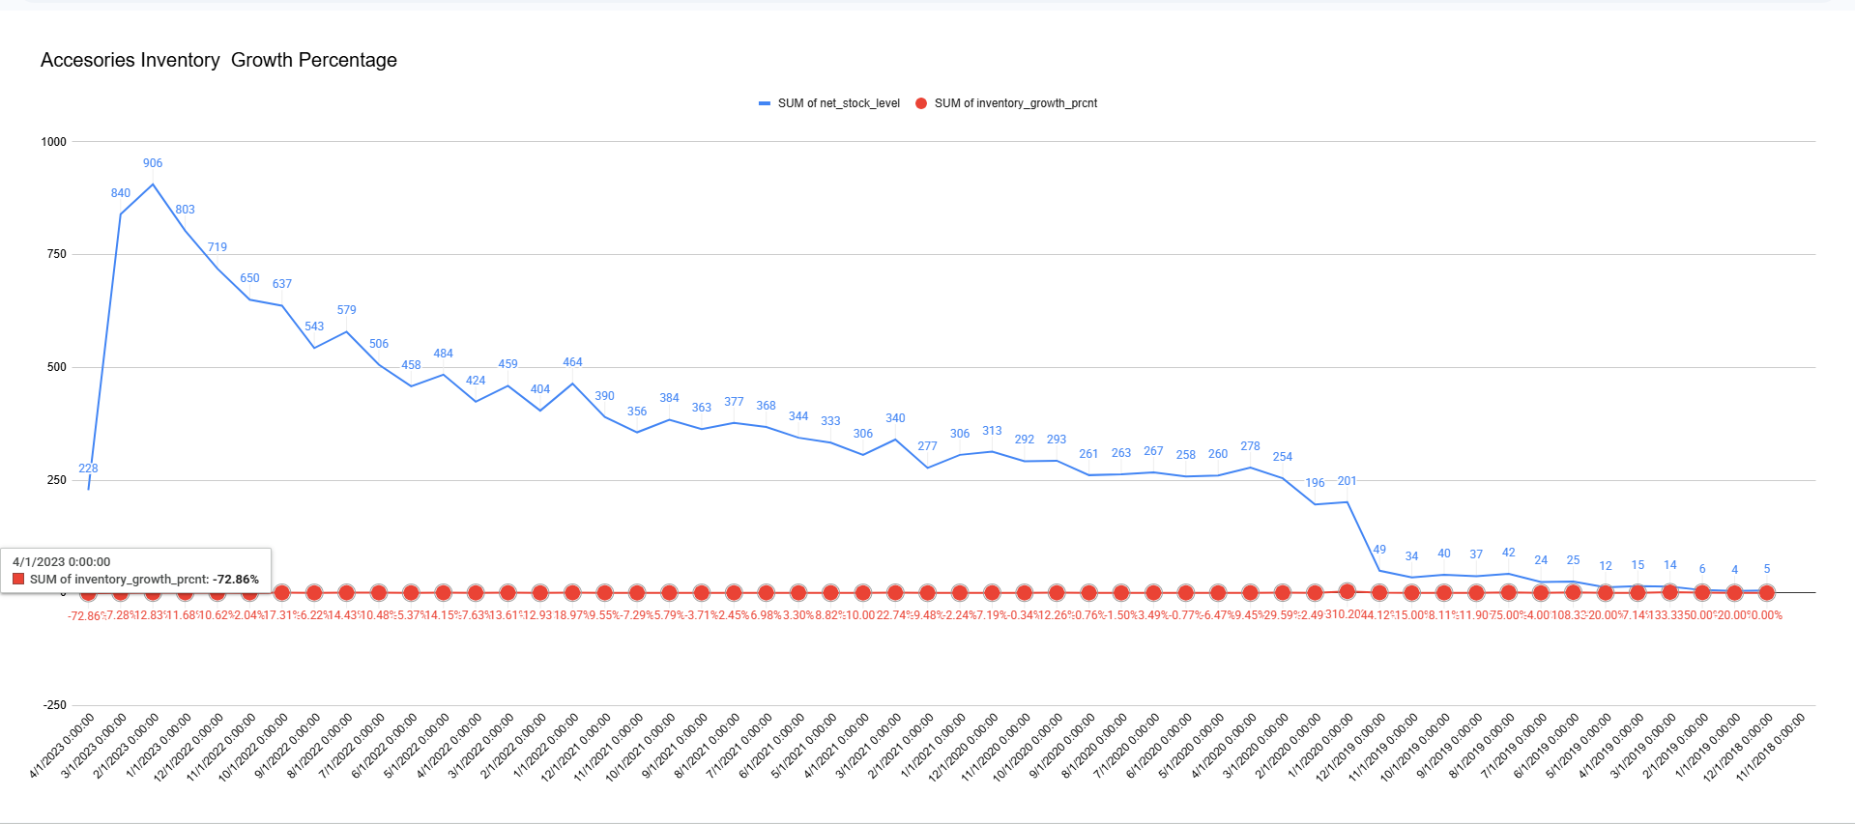
Visualization Spreadsheet

Slide 7
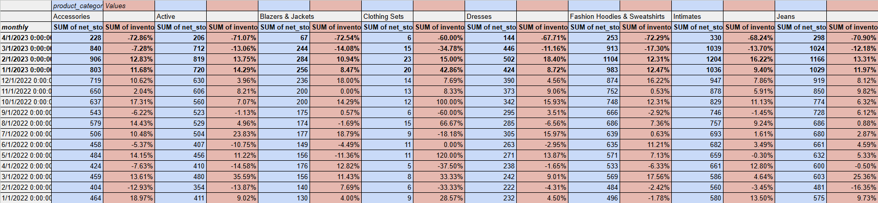
Insight Derivation
1.Inventory Trend
In the last 2 month inventory quantity and percentage experienced drop, with the worst drop happen on April 2023 with 50% + across all categories, This reversal is highly uncharacteristic, as it follows a sustained period of steady positive growth
2. Overall Categories
All product categories experienced the same condition , with all segments experiencing a drop of over 50%, confirms that the issue is not limited to category-specific stocking strategies; rather, it indicates a systemic operational failure

Slide 8
Insight Derivation
Company Context (with BCG Matrix)
1. Optimization Impact & Inventory Crisis
Potentially the Look management team trying to optimize the budget in order to reinvest the budget to something else, potentially for the “star” (high shares-high growth) in this case they might cut stock acquisition cost, resulting on steep decline on inventory quantity, this decline either foreseen or not are proven to be detrimental as at that rate, the company is at risk to losing sales due to out-of-stock
2. Systematic Resource Allocation
The strategy to liquidate the pets (low-growth and low-shares categories) has backfired. Instead of targeting specific areas, the reduction has caused a universal decline across all product categories. This indicates a failure in how the optimization was implemented.

Slide 9
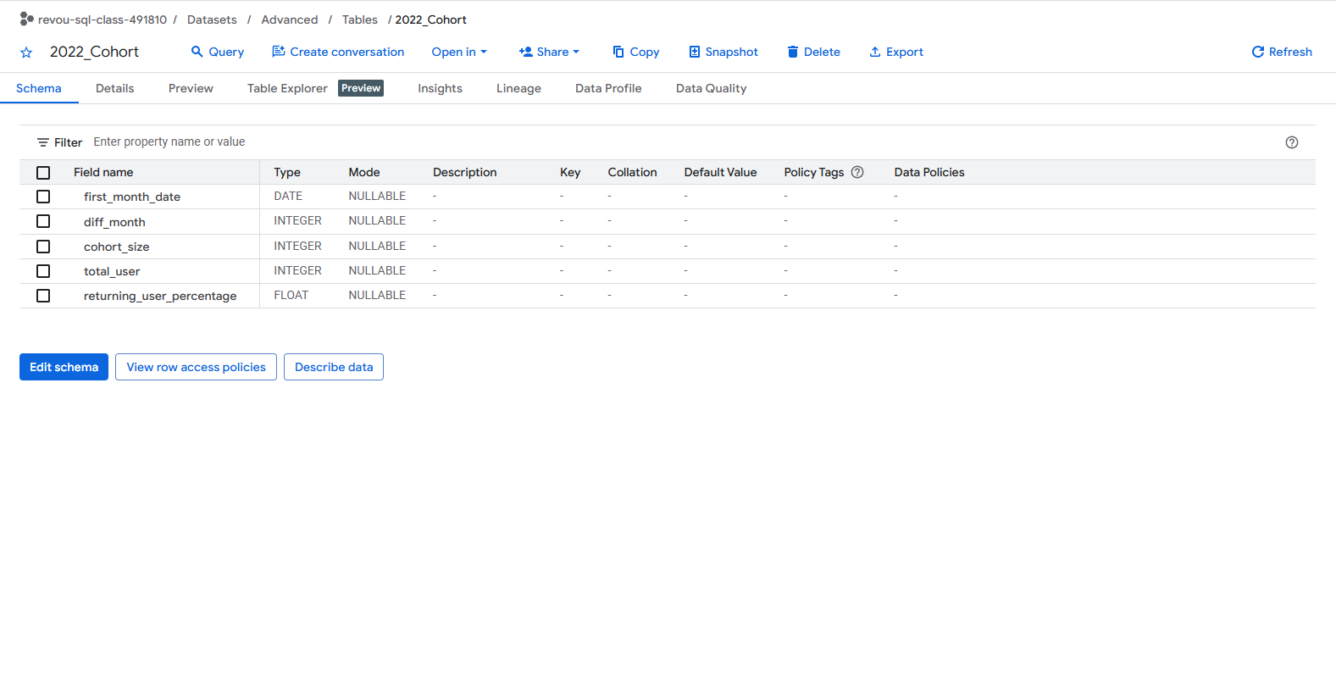
Table and Scheme preview

Slide 10
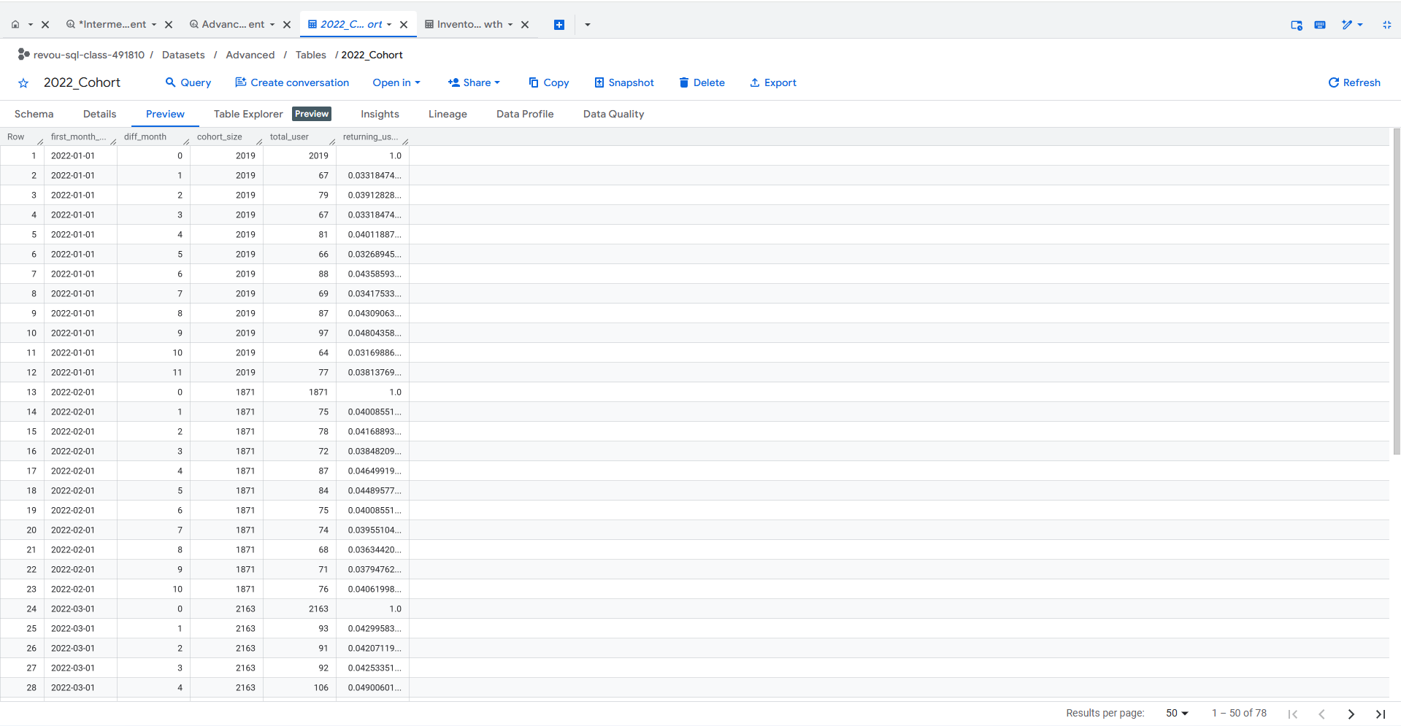
Table and Scheme preview

Slide 11
2022 Cohort Analysis Syntax Advanced_Query
WITH cte_1 AS (
SELECT DISTINCT
user_id,
--Mencari kapan transaksi pertama
MIN(DATE_TRUNC(DATE(created_at),month)) OVER (PARTITION BY user_id) AS first_month_date,
--Mencari transaksi selanjutnya
DATE_TRUNC(DATE(created_at),month) AS running_month_date
FROM `fsda-sql-01.TheLook_Ecommerce.orders`
),
cte_2 AS (
SELECT
*,
--Mencari selisih waktu belanja awal dan belanja selanjutnya
DATE_DIFF(running_month_date,first_month_date,month) AS diff_month,
--Mencari jumlah cohort bulanan
COUNT(DISTINCT user_id) OVER (PARTITION BY first_month_date) as cohort_size
FROM cte_1
),
cte_3 AS (
SELECT
first_month_date,
diff_month,
cohort_size,
--Mencari user yang melakukan pembelian lagi sesuai running month masing"
COUNT(DISTINCT user_id) AS total_user
FROM cte_2
WHERE first_month_date BETWEEN "2022-01-01" AND "2022-12-31"
AND running_month_date BETWEEN "2022-01-01" AND "2022-12-31"
GROUP BY 1,2,3
)
SELECT
*,
ROUND(SAFE_DIVIDE((total_user), cohort_size) * 100, 2) AS returning_user_percentage
FROM cte_3
ORDER BY 1,2

Slide 12
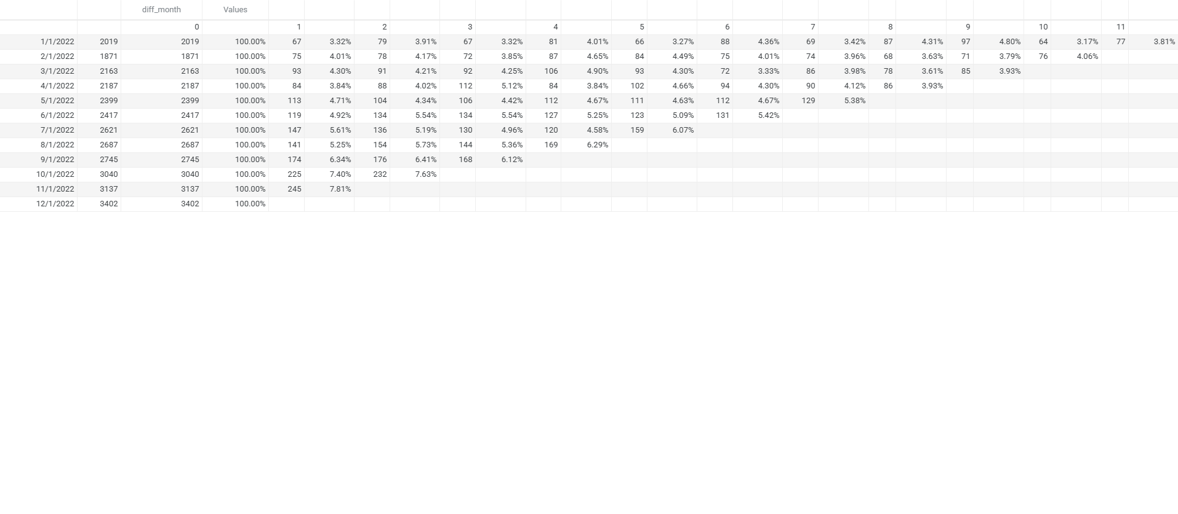
Visualization SpreadSheet

Slide 13
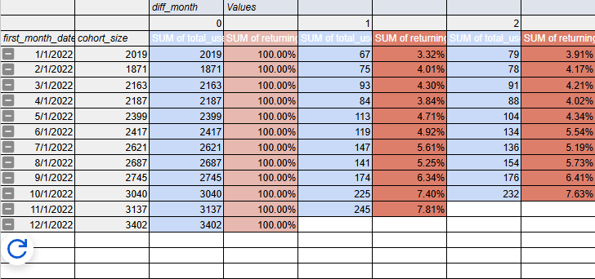
Insight Derivation
Customer Behaviour
Retention Rate on TheLook eCommerce is so low with only 3-8 % user completed transaction after the following month of their first purchase, this might possibly happen because low customer satisfaction ( product, system , etc)
Customer Base
With around 90-95% Customer Churn Rate after initial purchase TheLook customerbase health is severely at risk, because this indicate most of its customer are bargain/promo hunter
Compare Groups
Over the time the TheLook Retention Rate steadily growing especially from the newest batch of customer, might indicating company awarness and willingness to adress and fix this matter
Acquisition Cost
Big Customer Churn Rate will also hinder the Customer Acquisition Cost Efficiency , indicating TheLook campaign model is unsustainable and need to be revised
Reacceleration
Several months with higher customer than previous month, might indicate shift on customer trend, or seasonal. Further analysis are required.

Slide 14
Insight Derivation
Company Context (with BCG Matrix)
Shift in company policy
The rising retention and acquisition numbers suggest that management has redirected its efforts toward customer experience and loyalty. However, this shift likely came at the cost of the Inbound and Inventory budget. While the customer side is thriving, the supply side is struggling to keep up, creating a gap between high demand and low stock.
Star Categories Prioritization
By liquidating "Pets" and reinvesting in "Stars," the company has significantly improved the quality of its product selection. Providing a more curated and high-performing catalog that potentially increases customer satisfaction. This improved experience makes customers more likely to return, driving a steady increase in the Retention Rate.

